Slide 1
进度报告 CCA +mTRF结果分析
李佳蔚
2017.8.6

Slide 2
CCA speaker listener
频段选择：broadband 0.5-40Hz

Slide 3
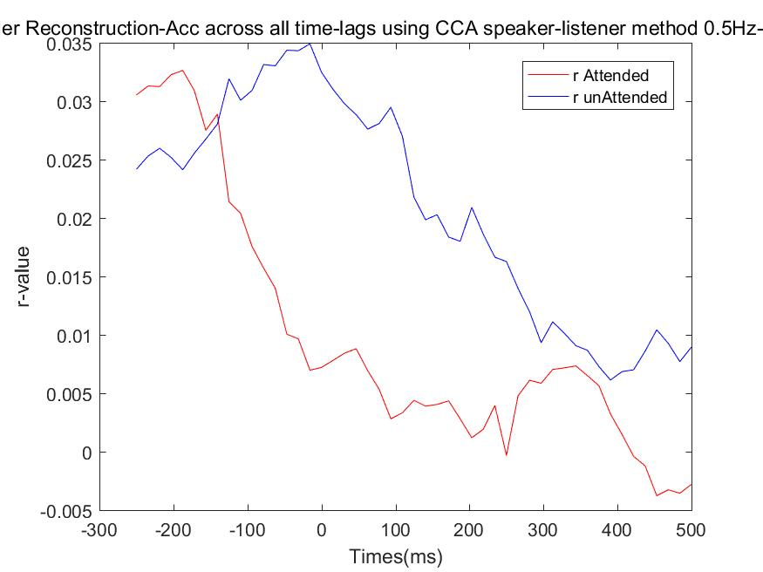
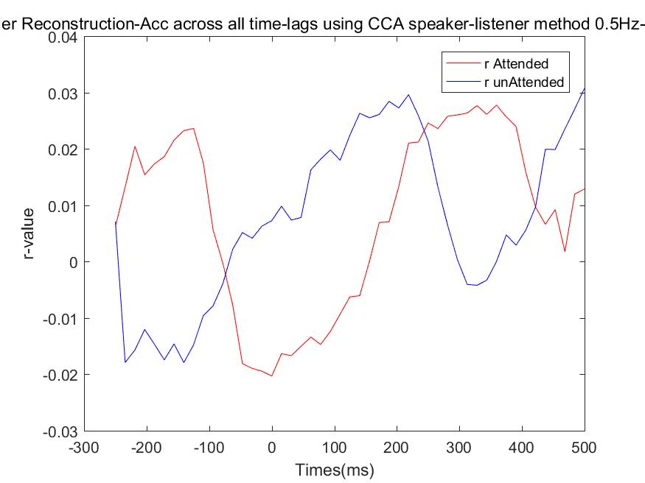
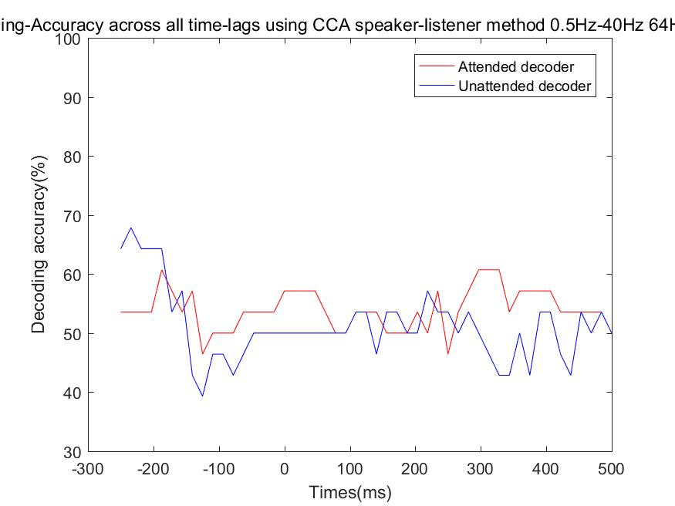
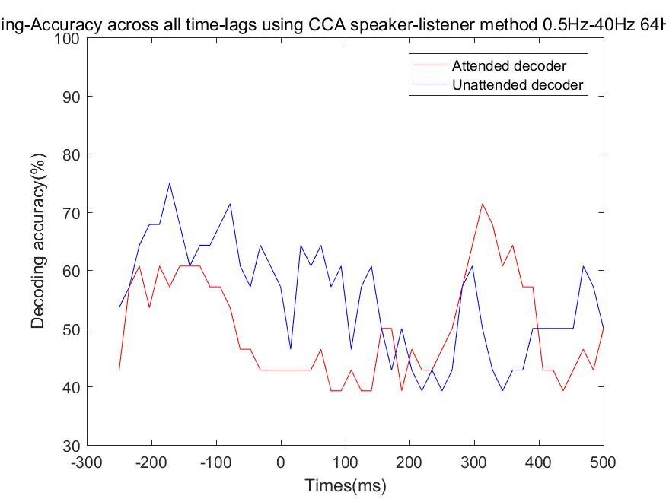
CCA speaker listener – listener11
R rank1
R rank3
r value
Decoding result

Slide 4
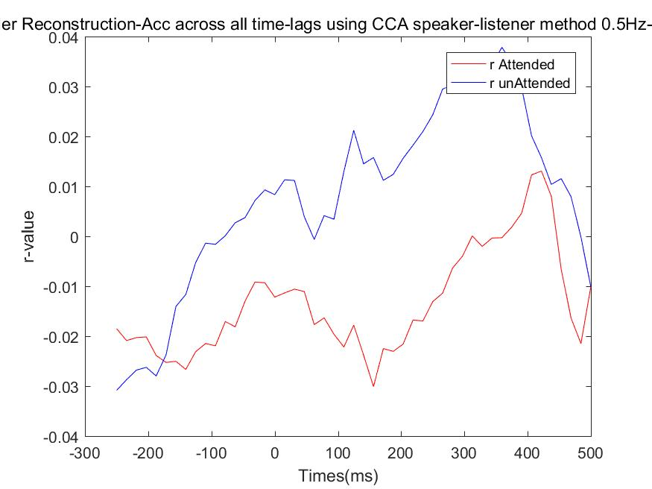
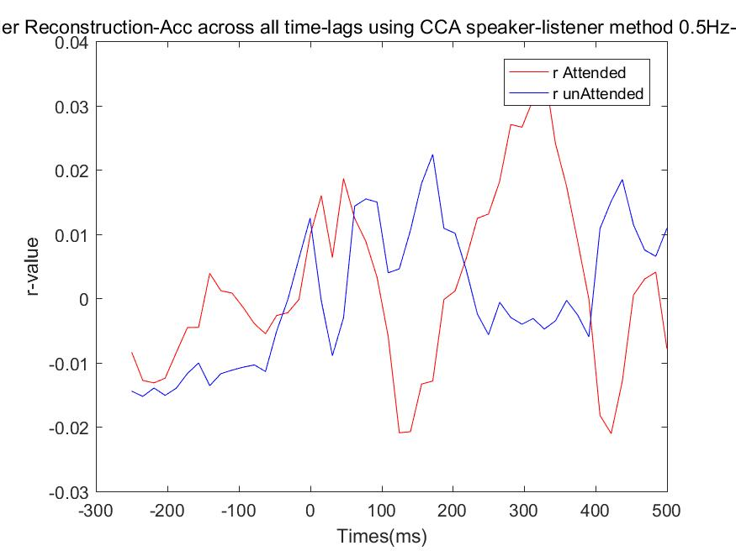
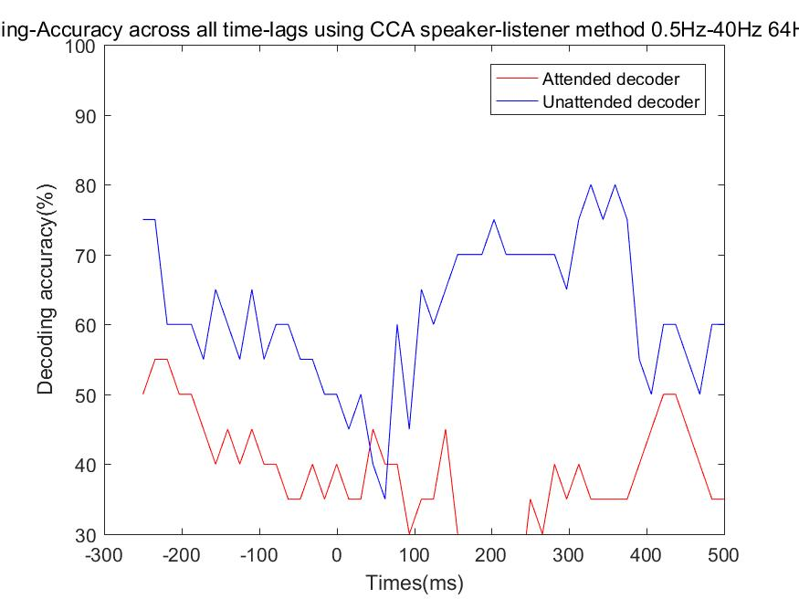
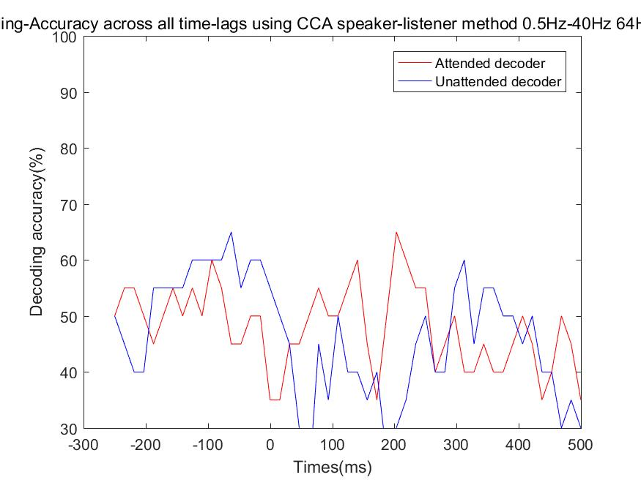
CCA speaker listener – listener12
R rank1
R rank2
r value
Decoding result

Slide 5
mTRF
频段选择：theta 2-8Hz

Slide 6
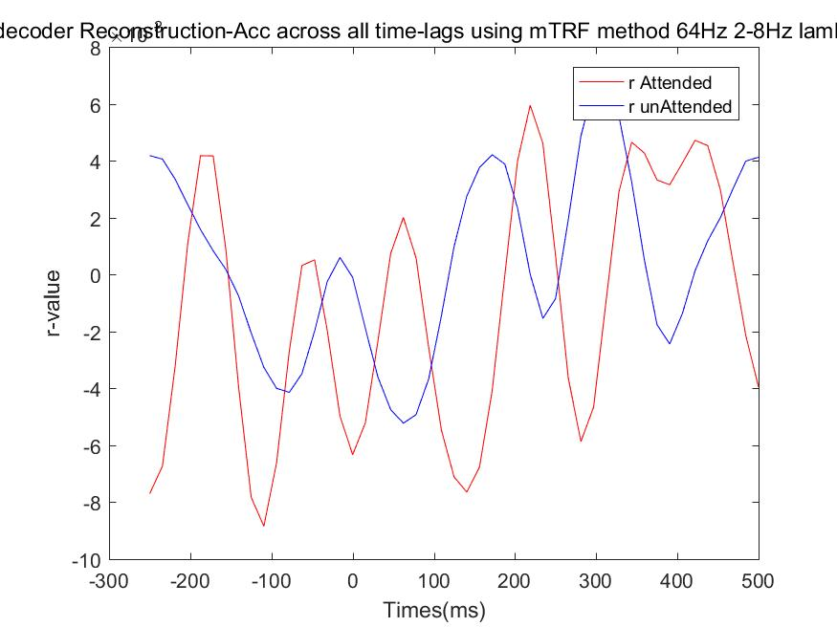
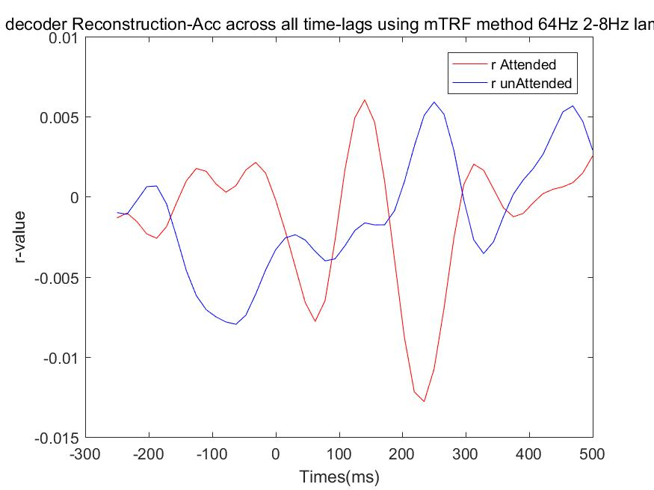
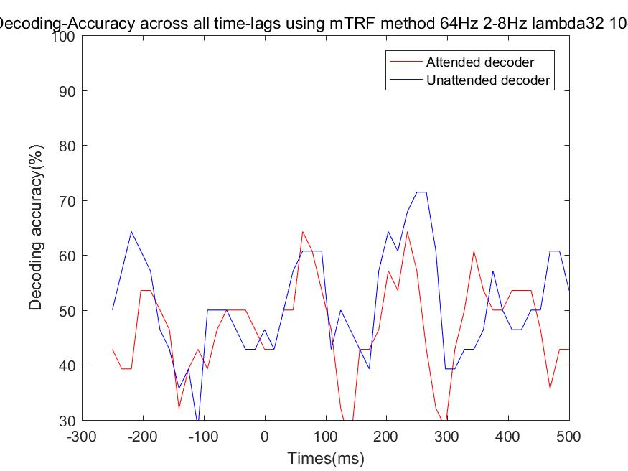
listener11
Attended decoder
Unattended decoder
Decoding Acc

Slide 7
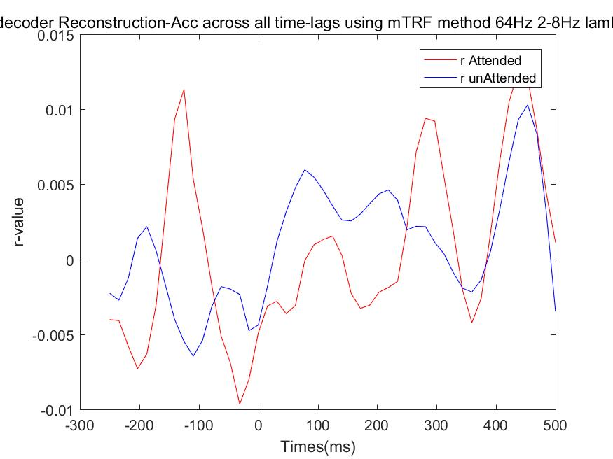
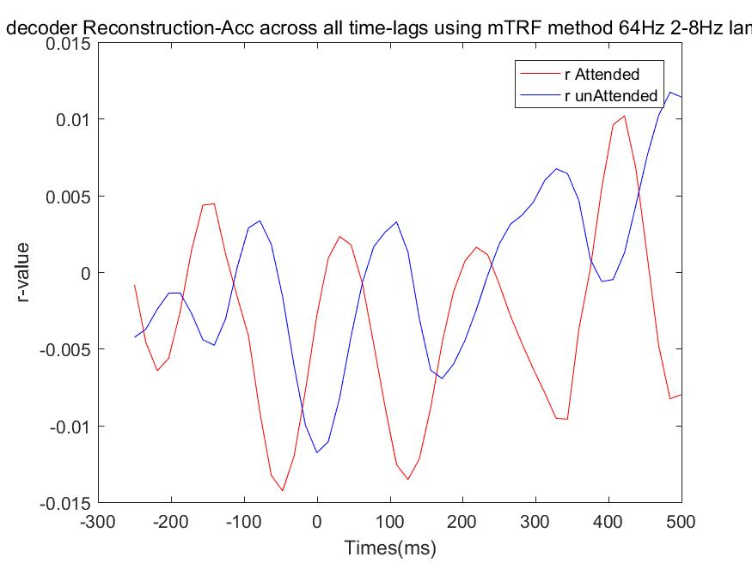
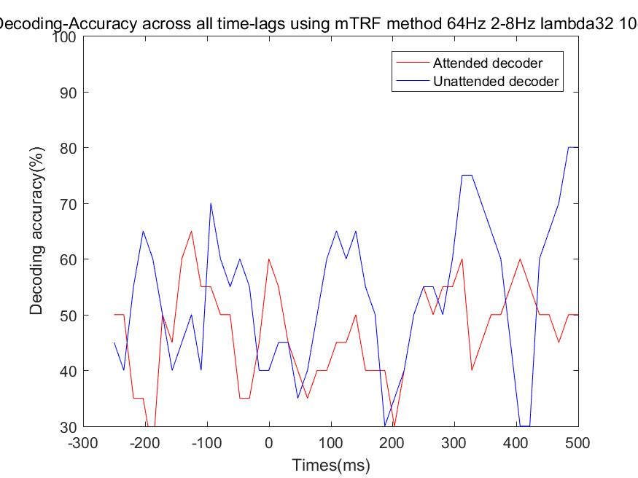
listener12
该listener只有20个story
Attended decoder
Unattended decoder
Decoding Acc

Slide 8
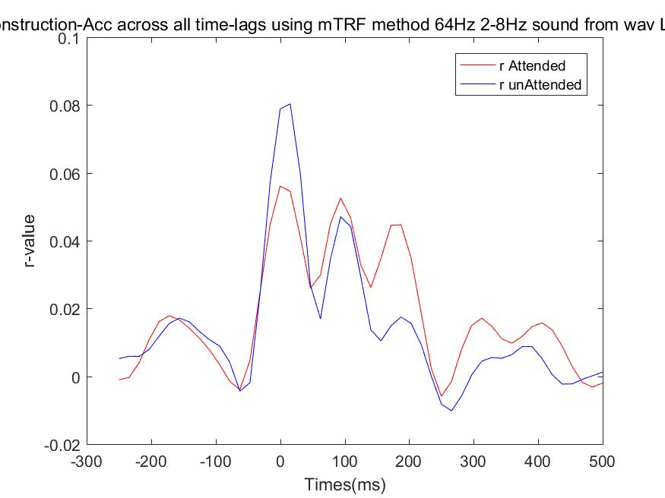
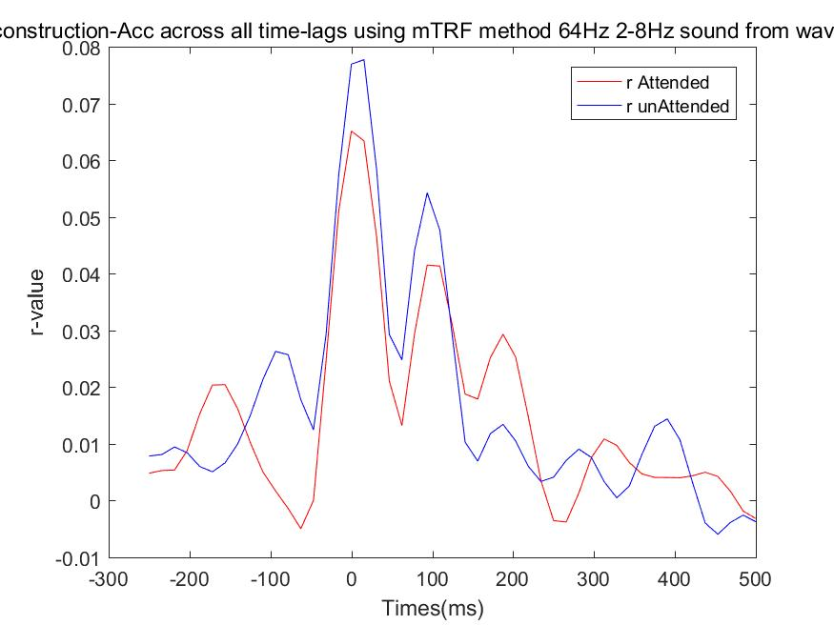
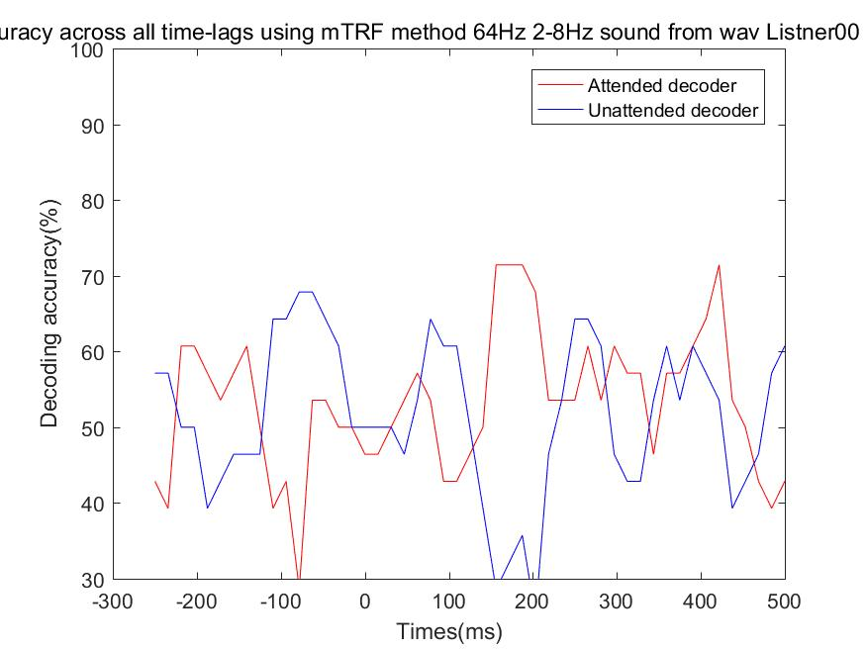
Listener0-预实验
该listener只有20个story
Attended decoder
Unattended decoder
Decoding Acc

Slide 9
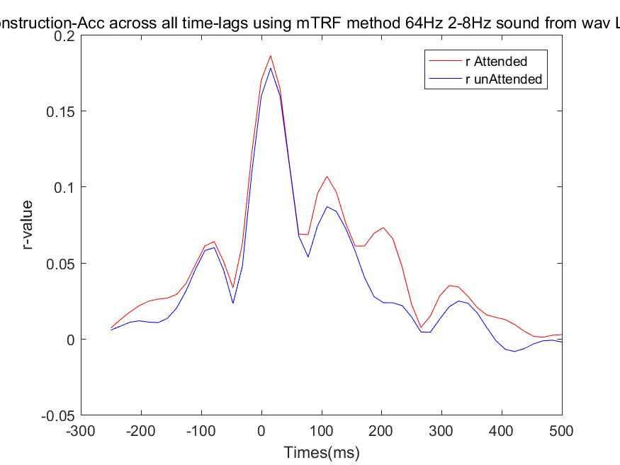
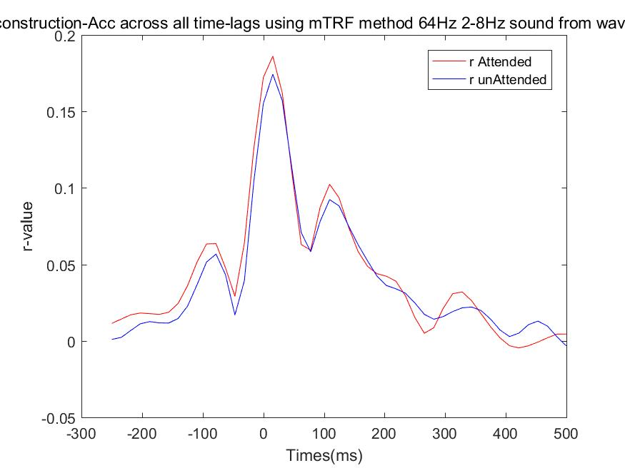
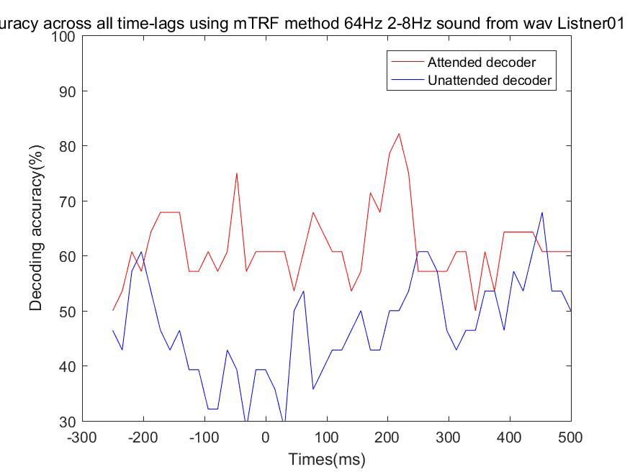
Listener01-预实验
该listener只有20个story
Attended decoder
Unattended decoder
Decoding Acc

Slide 10
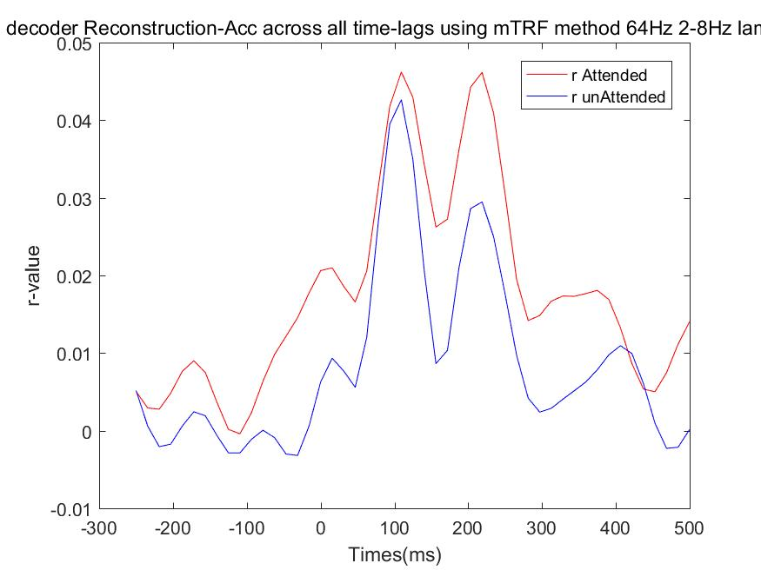
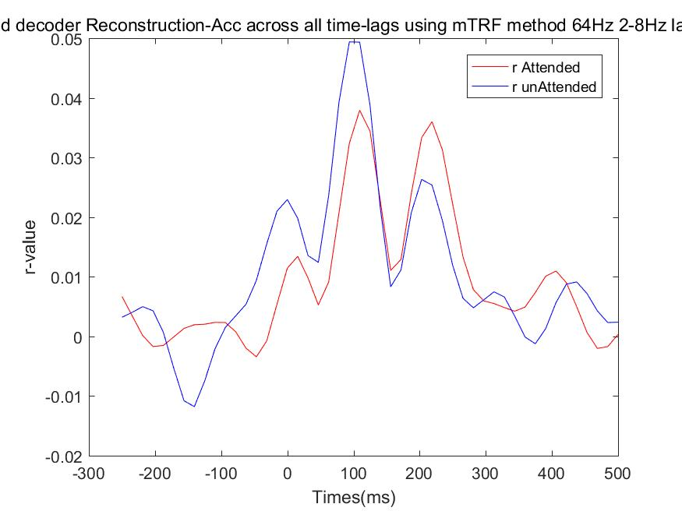
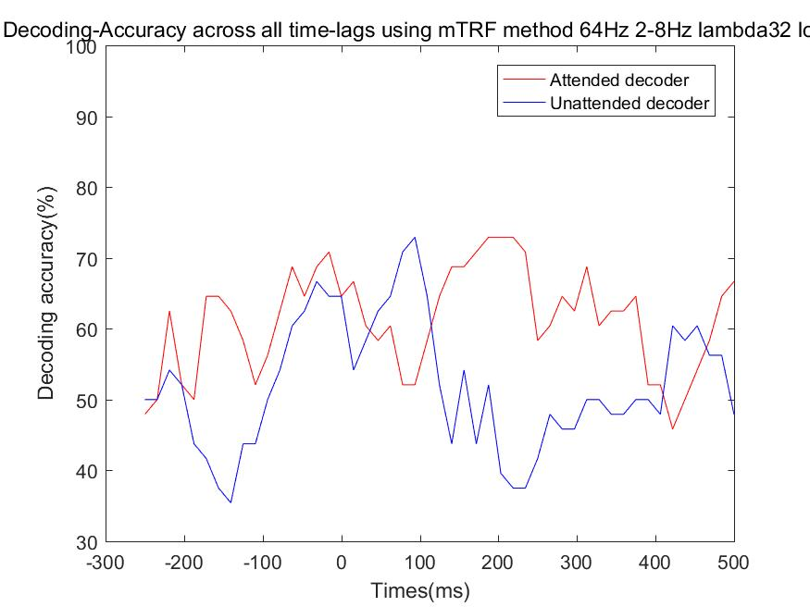
Mirkovic2015 JNE
Attended decoder
Unattended decoder
Decoding Acc

Slide 11
Thanks！

